Slide 1


Antecedents of Organizational Misbehavior: The Moderating
Role of Spirituality
Ora Setter, Ph.D.
Ely Weitz, Ph.D.
Yoav Vardi, Ph.D
Tel Aviv University, Israel

Slide 2
Spirituality at work – Individual (IS)
Distinct state that is characterized by physical, affective, cognitive, interpersonal, spiritual and mystical dimensions (Kinjerski & Skrypnek, 2004)
Self-workplace integration,
Meaning in work,
Transcendence of self,
Personal growth,
Harmony with self,
quest for feeling whole
Self actualization,
Sense of interconnectedness with community and environment,
Expressions of humility, courage, compassion, fairness
Sense of responsibility

Slide 3
Organizational spirituality (OS)
“Organizational culture guided by mission statement, leadership and business practices that are socially responsible and value driven, that recognizes the contributions employees make to the organization, that promotes individual spiritual development and well being”
(Kinjerski & Skrypnes, 2006)

Slide 4
Dimensions:
Meaningful work that is for life and not only for living
Hopefulness, the belief that organizational goals can be achieved;
Authenticity, the alignment of people's actions with their core values and beliefs;
The employee feeling as whole human being;
A sense of community, of interconnectedness and interdependence, care for the world at large, for the social and natural environment;
Respect for diversity;
Work that has a meditative ‘flow’, being at one with the activity

Slide 5
Current Research on workplace spirituality : Positive Outcomes
Employees’ values, beliefs, attitudes, behaviors and their very well being
Overall functioning and performance of the organization

Slide 6
But What about the Negatives? Introducing OMB
Organizational misbehavior (OMB) is defined as any intentional action by member/s of organization/s which defies and violates
Shared organizational norms and expectations, and/or
Core societal values, mores and standards of proper conduct
(Vardi & Wiener,1996, p.151).

Slide 7
OMB (Organizational Misbehavior) is:
Pervasive - an integral component of organizational reality and an important facet of individual, group and organization conduct – not a marginal, negligent (that is deviant) organizational occurrence
Intentional work related behavior
Bearing mostly – but not only – negative consequences to both individuals (perpetrators and targets) and the organization, both personal and economical
Certain misbehaviors can de dealt by the law, or the code of ethics, some not
Normal (not socio-path or psycho-path) Behavior

Slide 8
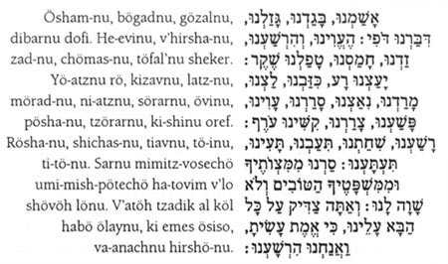
Jewish Confession in Kippur Day
We have transgressed, we have acted perfidiously, we have robbed, we have slandered. We have acted perversely and wickedly, we have willfully sinned, we have done violence, we have imputed falsely. We have given evil counsel, we have lied, we have scoffed, we have rebelled, we have provoked, we have been disobedient, we have committed iniquity, we have wantonly transgressed, we have oppressed, we have been obstinate. We have committed evil, we have acted perniciously, we have acted abominably, we have gone astray, we have led others astray.
ABC list of sins (in the plural)

Slide 9
The full range of behaviors:
OCB – Organizational Citizenship Behavior
OB – Organizational Behavior (“normal”)
OMB – Organizational Misbehavior

Slide 10
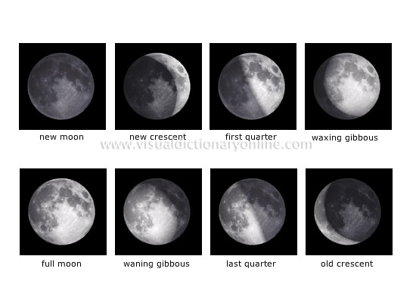
Phases of the moon

Slide 11
The metaphor of the moon
There is only one day in a month when we see the full moon
Most of the month, parts of the moon are hidden:
Half the month it is growing
Half the month it is getting smaller…
So are behaviors in organizations. We can rarely observe the full scope of the phenomenon. Most of the time, part of it is hidden….

Slide 12
Who will bear the brunt of OMB?
The actor - perpetrator
His team members and colleagues
The work itself
The work unit
The organization
The environment

Slide 13
Motivation
OMB: Three types of
Type S – benefits the perpetrator (Utilitarian motivation)
Type O – benefits the organization (Emotional)
Type D - Harms either individuals or the organization (both)
Vardi & Wiener (1992, 1996)

Slide 14
General Framework for OMB
Intra-personal Misbehavior
Individual Level
Inter-personal
Misbehavior
Position\Task Level
Intentions to Commit
OMB Types
S, O, D
Work Process
Misbehavior
Group Level
Property & Resource
Misbehavior
Organizational and Professional Level
Political Misbehavior
.

Slide 15
Intra-personal OMB
Self deception
Workaholism, burnout, stress
Alcohol and drugs abuse
Professional obsolescence

Slide 16
Inter - personal OMB
(Colleagues, subordinates, bosses, clients)
Degradation, insults, humiliation
Emotional abuse
Physical and verbal aggression
Psychological terror
Lies, deception, misinformation

Slide 17
Work processes OMB
Disobedience to instructions and norms
Intended quality reduction
Slowing down, restriction of productivity
Unjustified absence and lateness
Social loafing and free riding
Sabotage

Slide 18
Resourses and tools OMB
Theft (200 Billion & per year)
Use of company resources for personal use
Using work time for personal needs
IP theft, revealing company secrets and hurting reputation
Vandalism

Slide 19
Political OMB
Creating opposition, conspirations
Discrimination, favoritism, inequity
Impression management – for good or bad
Whistle blowing

Slide 20
Spirituality and Misbehavior
Our question is:
Would high individual spirituality and high organizational spirituality directly effect OMB and indirectly moderate the effect of internal and external constraints on the intention to misbehave?

Slide 21
Our Research Model
Dependent variable - OMB
Independent Variables
  Job Design: dependency, autonomy
  Procedural and distributive Justice
  Fulfillment of psychological Contract
  Personality – 2 of big 5 dimensions
Moderating Variables:
  Individual spirituality
  Organizational spirituality
Individual
Organizational
spirituality
Psychological contract
Justice
Autonomy
Dependency
Conscientiousness
OMB

Slide 22
Hypotheses
Job design dimensions, autonomy and interdependence, are directly and differentially related to an overall measure of OMB: the higher the job autonomy, the lower the OMB and the higher the job dependence, the lower the OMB.
Personality factors are directly and differentially related to an overall measure of OMB: Conscientiousness is negatively related to OMB while openness to experience is positively related to OMB.
Organization justice facets are directly and differentially related to an overall measure of OMB: Procedural, rewards and distributive justice are negatively related to OMB.
Perceptions of psychological contract fulfillment are negatively related to OMB

Slide 23
Hypotheses
5. Individual spiritually and organizational spirituality are negatively related to OMB.
Moderating effects:
6. Individual spiritually moderates the relationships proposed in Hypotheses 1-4.
7. Organizational spirituality moderates the relationships proposed in Hypotheses 1-4.

Slide 24
Methods

Slide 25
Sample (N=137)
Gender: 55 males and 72 females
Age: range from 26 to 40
Education: 61% had a bachelor degree, 20% had a graduate degree
Position: 54% of the participants were holding managerial position.

Slide 26
Measures
OMB - 22 questions taken from Vardi & Weitz, 2004
Job design – interdependence and autonomy, Work Design Questionnaire, Morgeson & Humphrey (2000)
Procedural Justice – Joy & Witt, 1992
Distributive and rewards Justice - Price and Mueller's (1981)
Psychological Contract fulfillment – Setter (2001)
Personality - Conscientiousness and openness to experience - Big Five questionnaire, Wagner et al., 2007

Slide 27
Measures
Individual spirituality: the Spirit at Work scale (Kinjerski & Skrypnek, 2006) which has 18 items forming 4 subscales: Engaging work, Mystical experience (or flow), Spiritual connection and sense of community.
Organizational spirituality : the Organizational Spiritual Values Scale (OSVS) ,Kolodinsky, Giacalone, and Jurkiewicz (2008). A 20 items scale.

Slide 28
Results

Slide 29
Means and SD of the variables
SD | Mean | Variable
.60 | 2.04 | OMB
.96 | 3.59 | Dependence
.85 | 4.69 | Autonomy
.89 | 4.73 | Procedural Justice
.90 | 4.74 | Distributive Justice
1.35 | 3.86 | Reward Justice
1.10 | 3.80 | Individual spirituality
1.04 | 3.65 | Organization spirituality
.99 | 4.02 | Psychological contract
.98 | 4.40 | Openness to experiences
.74 | 5.34 | Conscientiousness

Slide 30
Correlation Matrix (N-137)
 |  | 1 | 2 | 3 | 4 | 5 | 6 | 7 | 8 | 9 | 10
1 | OMB | α=.89
2 | Dependence | -.01 | α=.71
3 | Autonomy | -.16 | .05 | α=.78
4 | Procedural Justice | -.01 | .07 | .68** | α=.80
5 | Distributive Justice | -.26** | .05 | .37** | .41** | α=.67
6 | Reward Justice | -.23** | .12 | .15 | .00 | .44** | α=.95
7 | Individual spirituality | -.10 | .06 | .48** | .48** | .42** | .16 | α=.95
8 | Organization spirituality | -.21* | .09 | .33** | .37** | .52** | .29** | .68** | α=.949
9 | Psychological contract | -.25** | .11 | .46** | .38** | .59** | .45** | .61** | .56** | α=.89
10 | Openness to experiences | -.01 | .15 | .10 | .23** | .16 | -.07 | .25** | .16 | .-07 | α=.64
11 | Conscientiousness | -.03 | .01 | .11 | .21* | .22* | .09 | .35** | .31** | .27** | .15

Slide 31
Pearson correlations
Autonomy and OMB are not related (0.1)
Inter dependency and OMB are not related (-.16)
Procedural Justice and OMB are not related (-.01)
Distributive and Rewards Justice and OMB are significantly negatively related (-.26**, -.23**)
Fulfillment of the Psychological Contract and OMB are significantly negatively related (-.25**)
Openness to experience and conscientiousness are not related (-.01, -.03)
Notes:
שימו לב- ייתכן כי כלי המחקר של ה- BIG5 לא מהימן מספיק

Slide 32
Spirituality and OMB – Pearson corr.
Individual spirituality is NOT related to OMB (-.10)
  (But is correlated to Autonomy, (48***. ) Procedural and Distributive Justice measures (.48**,.42**) openness to experience and conscientiousness (.25** and .35**).and quite strongly to organizational spirituality (.68**), and the fulfillment of the psychological contract (.61**)
Organizational spirituality IS negatively related to OMB
(-.21*)
  (And is correlated to all variables except Dependency and openness to experience).

Slide 33
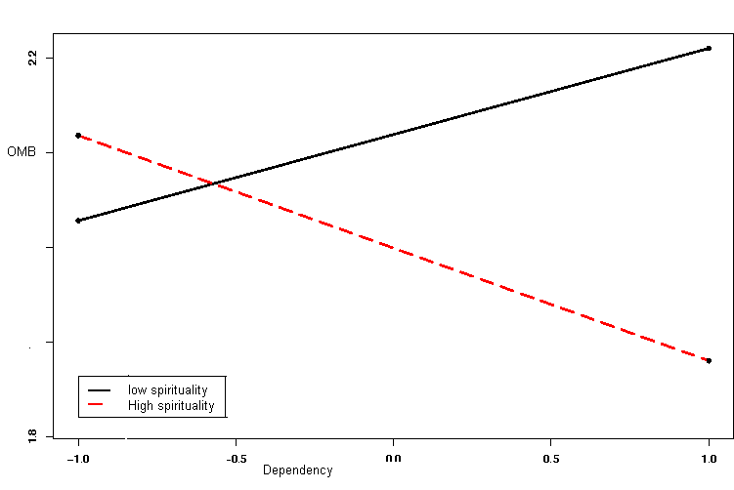
Interactions: Dependency and OMB

Slide 34
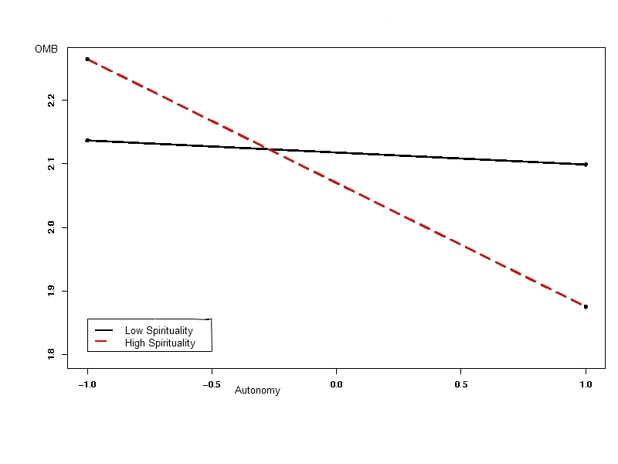
Interactions: Autonomy and OMB

Slide 35
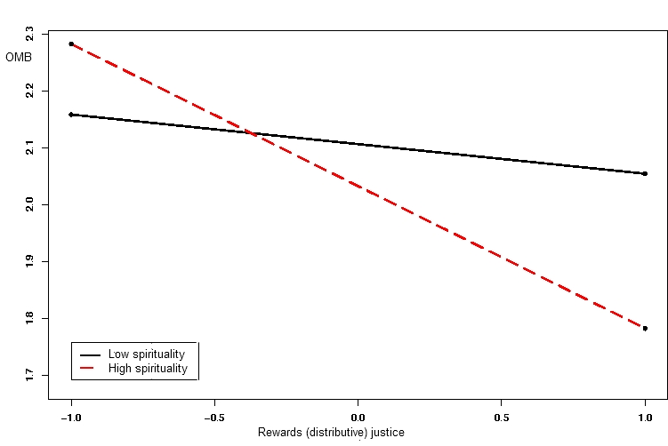
Interactions: Reward Justice and OMB

Slide 36
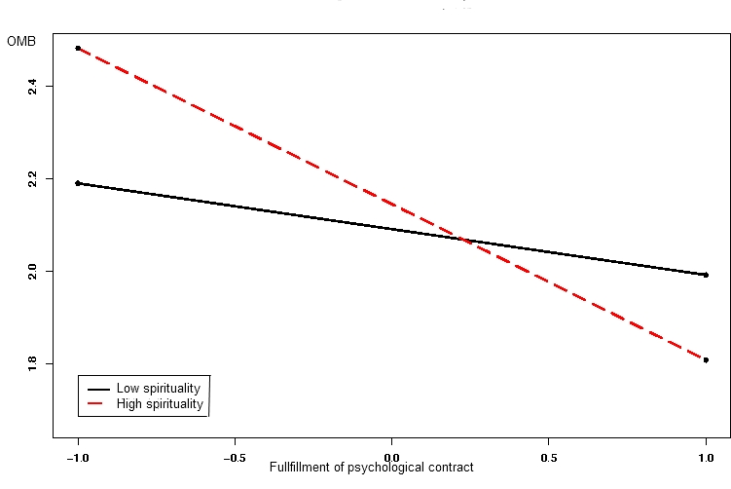
Interactions: Psychological Contract and OMB

Slide 37
Discussion

Slide 38
Our assumption was that…
When controlling for individual, job and organizational characteristics, spirituality should moderate employees' misbehavior at work.
The rationale was that even in face of both objective and subjective circumstances that may cause members to be inclined to engage in acts of misconduct, being spiritual or being in a spiritual workplace environment, should lessen such inclinations.

Slide 39
Our surprising findings about Individual Spirituality demonstrate that:
Contrary to our hypotheses, Individual spirituality has no direct effect on OMB
In line with our assumption, IS does moderates the relations hips between several antecedents and OMB. However:
Contrary to our assumption, respondents perceiving themselves as low in spirituality are less influenced by external, contextual variables, whereas highly spiritual people are more affected by them: In “good” situation they scored less in OMB, but in “dire” situation they inclined to higher degree of OMB

Slide 40
Are highly IS people more sensitive to context?

Slide 41
Three possible explanations:
Claiming to be spiritual does not mean living morally/ behaving morally (walk the talk…).
Issues with the validity of measurement tool of IS and possible social desirability, and problem with the OMB tool which is projected.
The very nature of spirituality, which focuses on the interdependence, interconnectedness, and totality of our very existence within the world: Highly spiritual people, may feel to be part and parcel, inseparable from their surroundings while low-spirituals may be more concerned with their very individuality.

Slide 42
Organizational spirituality
In line with our assumptions, OS has direct negative correlation with OMB. Thus joining other research findings that organizations who are perceived to be spiritual positively effect employees, even those who are not spiritual by themselves.
Contrary to our assumption, OS had no moderating effect on OMB: But having such strong correlations with justice and psychological contract fulfillment, it can be that they are all perceived as part of the same “just and caring” organizational culture construct.

Slide 43
Dealing with OMB
Preventive?
Responsive?

Slide 44
Dealing with OMB
Pre-employment: Selection
Socialization: Normative and instrumental
Behavior Control: Deterrence
Corrective Measures: minimizing the costs of the misbehavior, restoring the damage and providing assistance

Slide 45
Thank you!
Ora, Ely, Yoav
setter@post.tau.ac.il

